Slide 1
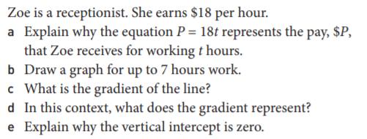
Topic: Linear Relationships
EQ: What is the “break-even”point between two linear relationships?
Get your VIVO’s
Topic and EQ in Interactive Notebook
NO PHONES OR EAR BUDS Some of you need reminders
ACT LIKE YOU HAVE IT
Have a go:
You will need graph paper and this question is timely in light of COVID-19

Slide 2
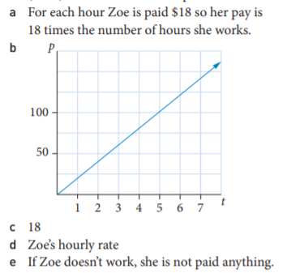
Topic: Linear Relationships
EQ: What is the “break-even”point between two linear relationships?

Slide 3
24
7
30
Date
Linear relationships
EQ: What is the “break-even”point between two linear relationships?
It is often useful to draw two linear graphs on the same set of axes
The point of intersection or “break-even point” is where the two line intersect.
At this point a few things can be noted but it is best to look at examples

Slide 4
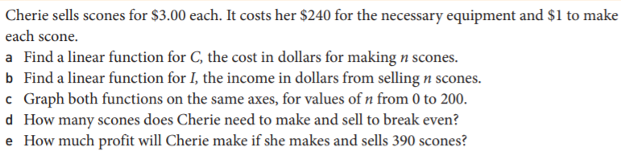
24
7
30
Date
Linear relationships
EQ: What is the “break-even”point between two linear relationships?
EXAMPLE: Please glue this copy in and work through the answers with me

Slide 5
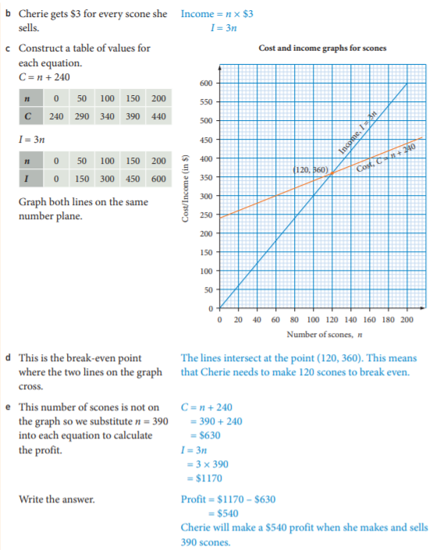
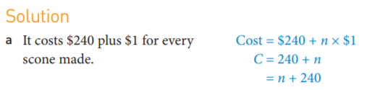

Slide 6
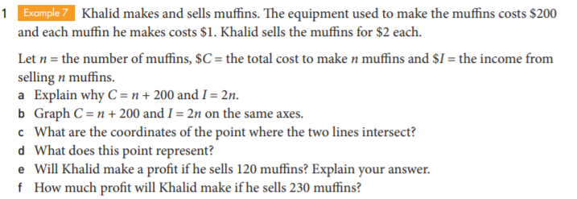
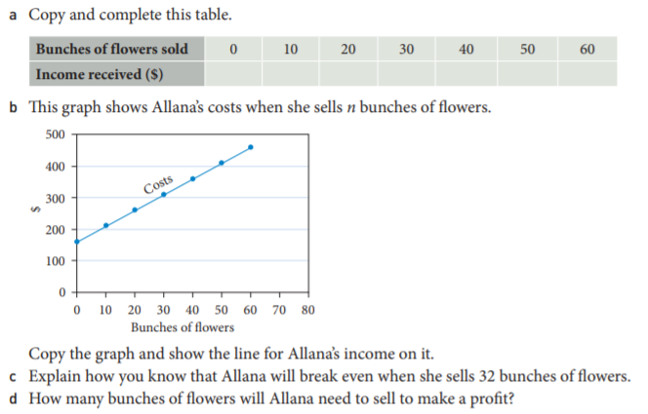

Slide 8
